Slide 1
Task 12 William Roberts CIS216 Prof. Stephen Leggett

Slide 2
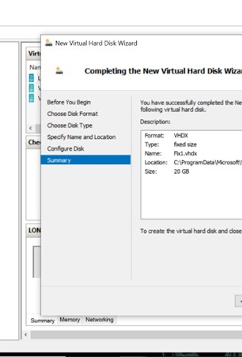
Creating a Virtual Hard Disk
Here I opened the Hyper-V application on my desktop and followed the steps to creating a fixed 20GB hard drive name Fix1

Slide 3
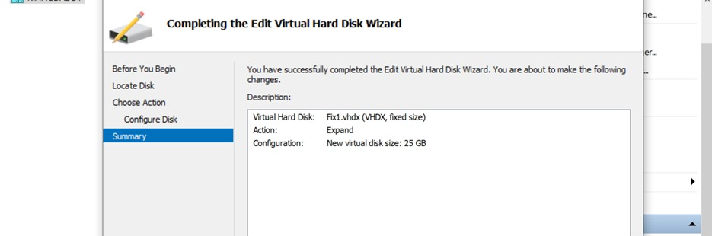
Editing a Virtual Hard Disk File
Here I followed the steps in Hyper-V to change Fix1 hard drive from 20 to 25GB.

Slide 4
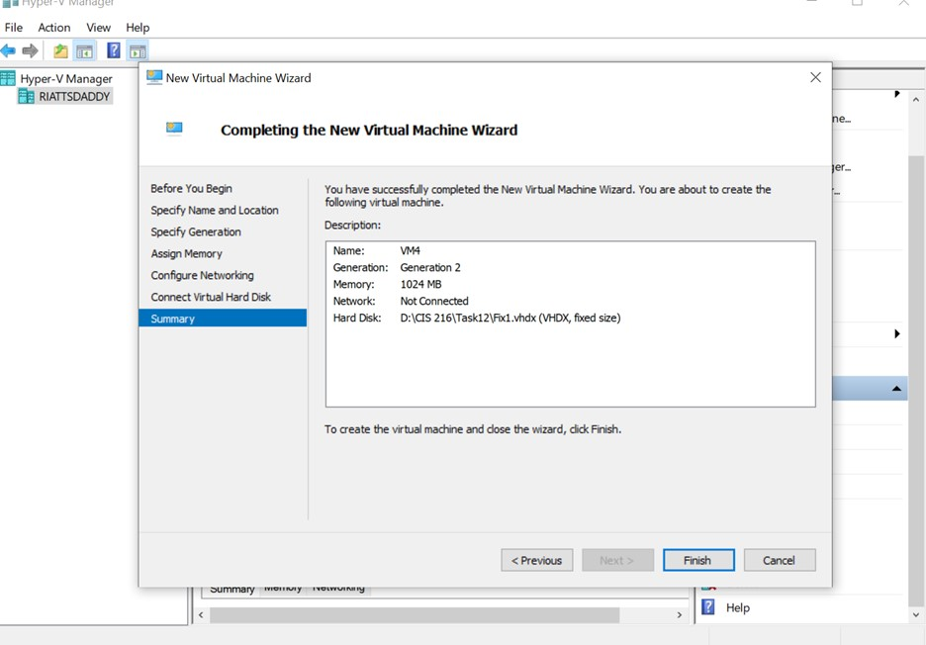
Creating a VM with an Existing Virtual Hard Disk
In this step I created a new VM name VM4 and attached the hard disk Fix1.

Slide 5
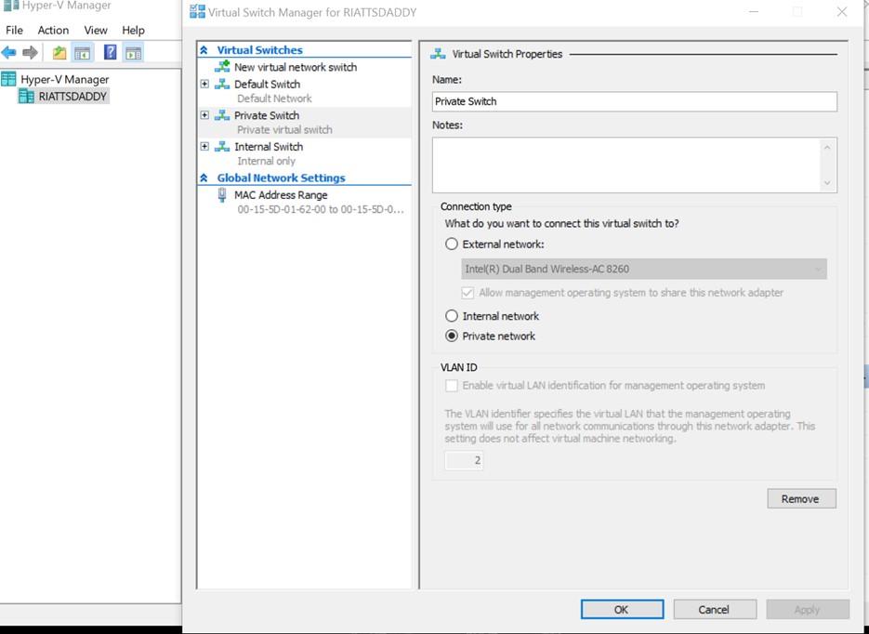
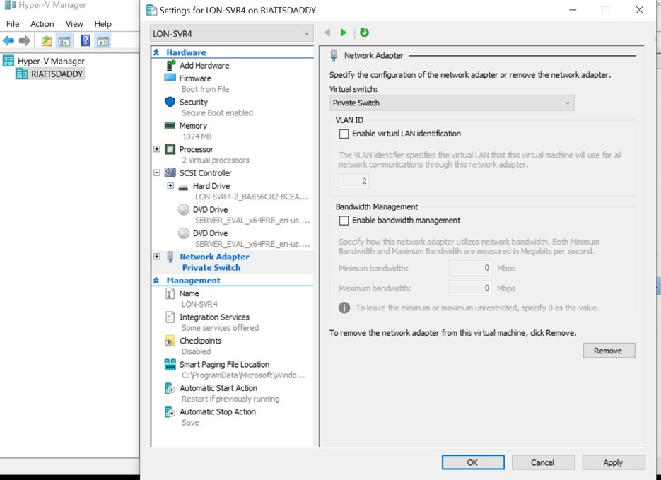
Creating and managing Virtual Switches
Here the Privet and Internal Switches were created.
I then assigned the privet switch to the VM

Slide 6
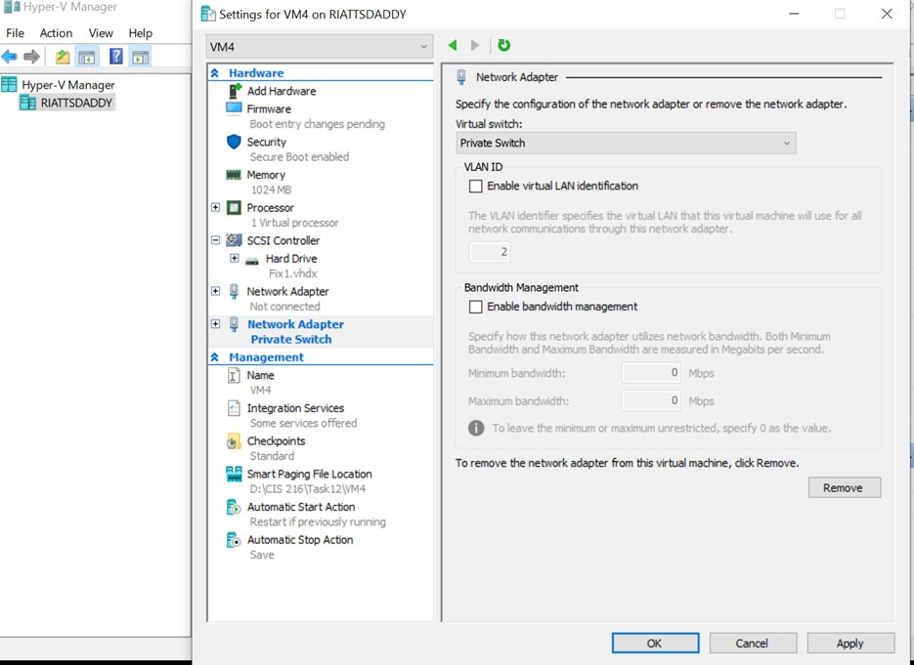
Adding a Virtual Interface Card
I then added the privet switch to VM4

Slide 7
Thank you

